Slide 1
Computer Turn On Process
07/03/2021

Slide 2
Terminology + Generals
Interrupt: All other programs stop running to service the “interrupt routine” → highest priority
HW has greater priority than SW
NVIC: Priority organizer (highest priority peripheral that determines every other priority)

Slide 3
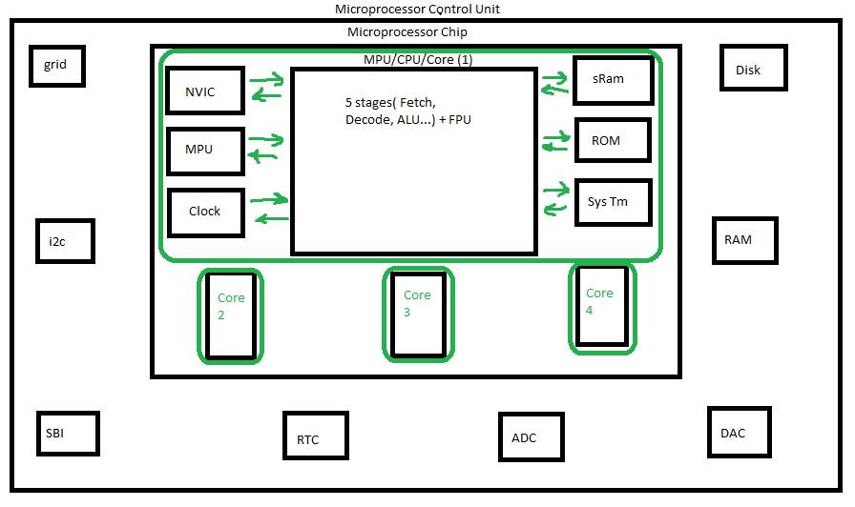

Slide 4

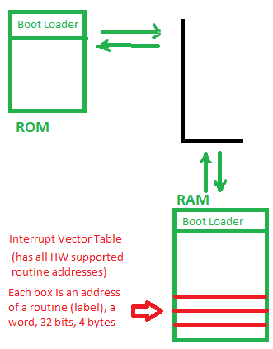
Boot Loader
Hardcoded into ROM
Responsible for bringing in OS (kernel), helps to decide with to run
BL is hardcoded in ROM
When does this happen: ISR (Interrupt Service Routine) (SW) copies BL from ROM to sRam and returns to the first line of the BL’s program
Program takes OS from the disk and takes it into RAM (Accesses the disk through Root FS)
At the end of this step, PC points to line 1 in the OS’s designated program

Slide 5
What is the OS?
Resource Manager
Scheduler
Summary: Determines which program can access which resources

Slide 6
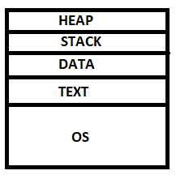
Turn On Steps
Lunches Init
Init is in charge of partitioning the RAM into the following sections →
Looks at init table (hardware information of the user) in disk
For every line, init launches a Getty (another file that compares username and password)
Getty launches Shell and ends

